Slide 1
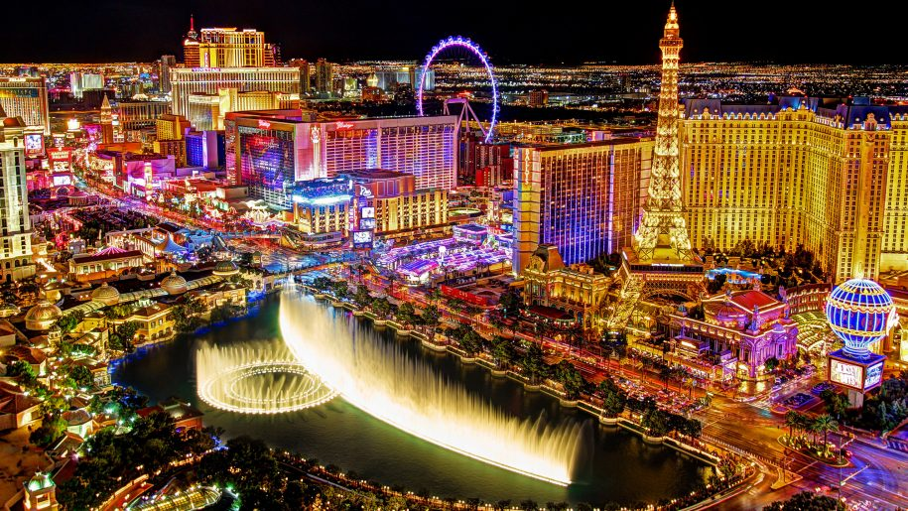

Sitecore 9: Symposium story
Daniel Mocan
Sitecore Architect, MVP 2017 @danimocan

Slide 2
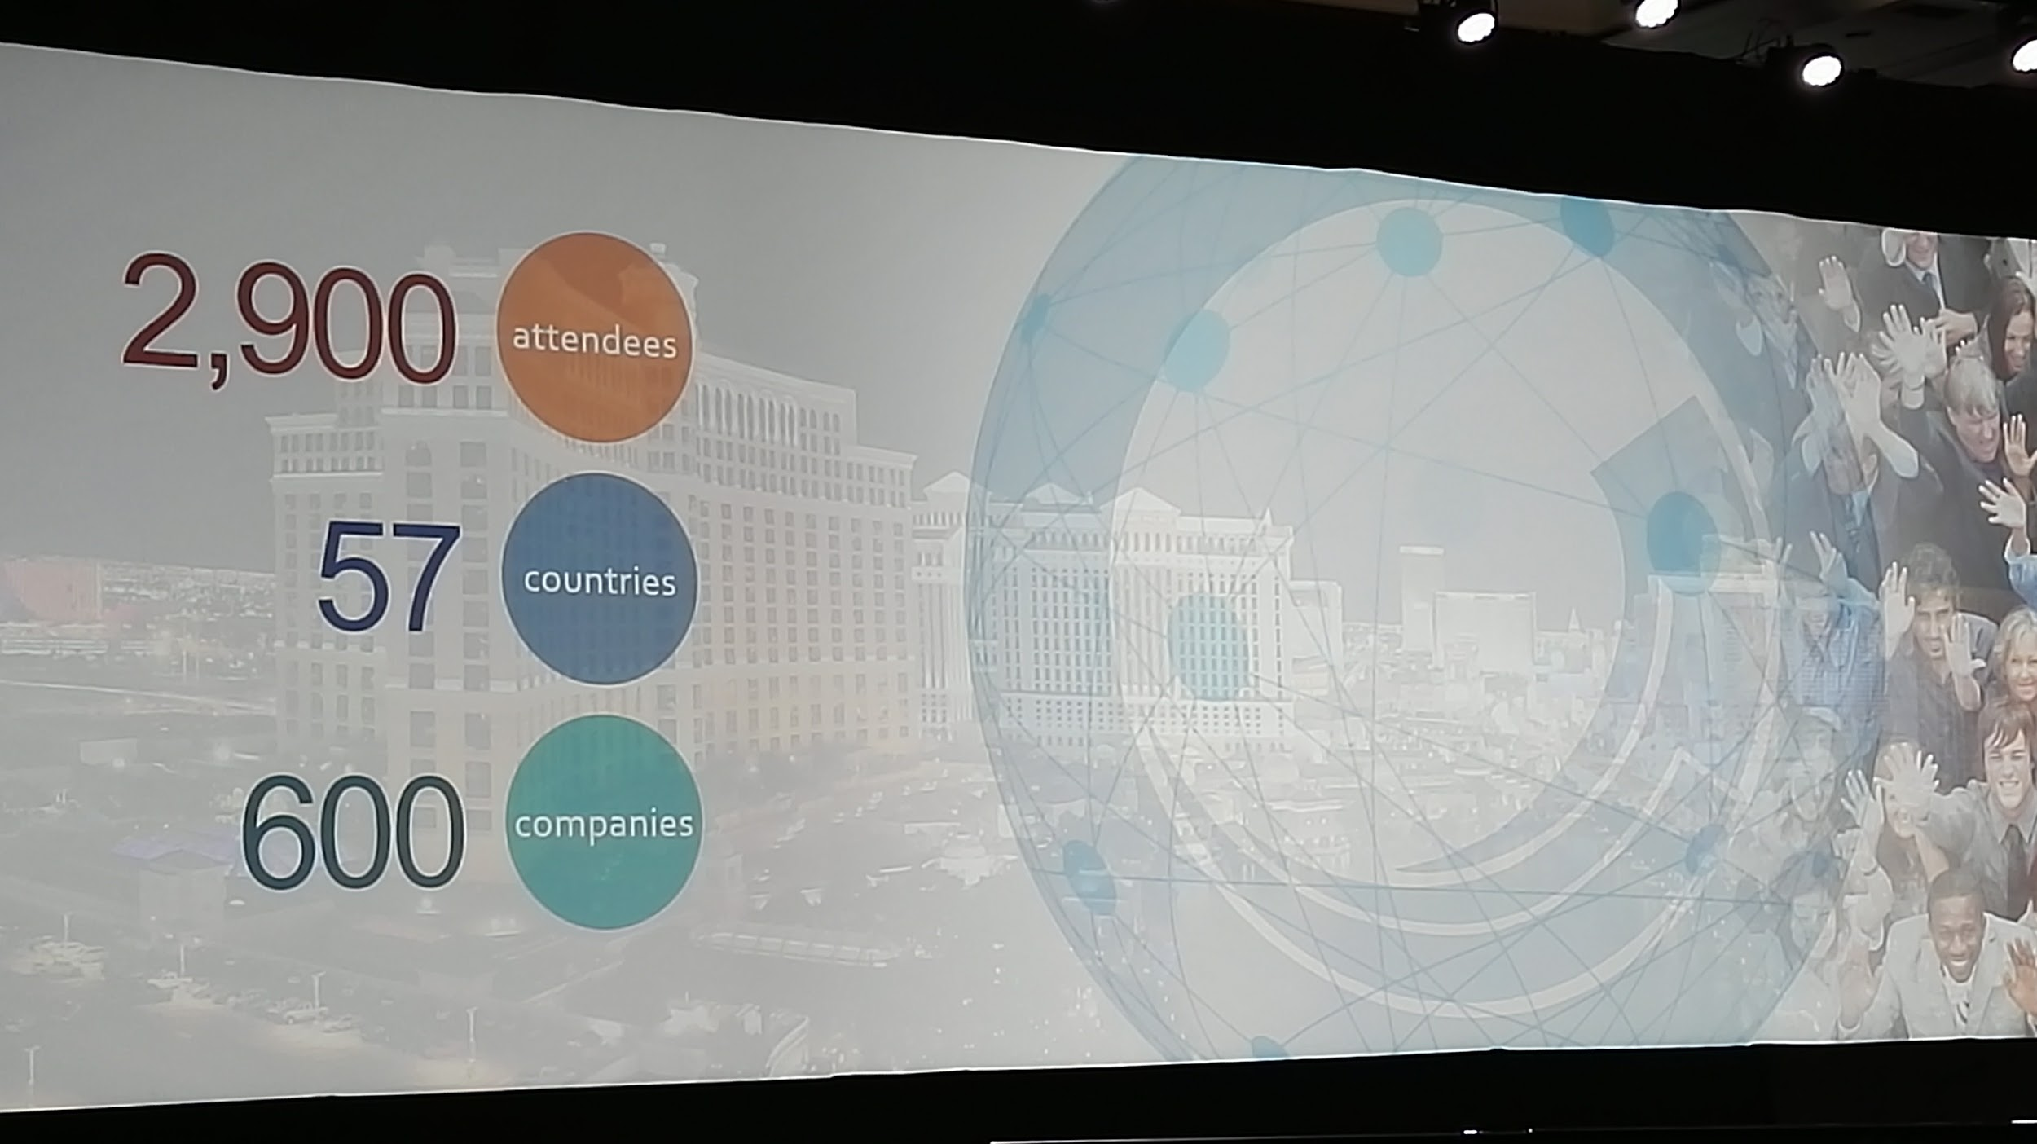
THE EVENT
The biggest Sitecore event so far!
The conference was held at the fabulous Mirage Hotel & Casino in Las Vegas, has been very well organized and lasted for 4 days.
Sitecore was hosting 2,900 attendees from 57 countries, from 600 different companies at the 2017 conference.
The Content was a mix of new product launches, customer and partner stories , inspiration on the future of machine learning and contextual marketing.

Slide 3
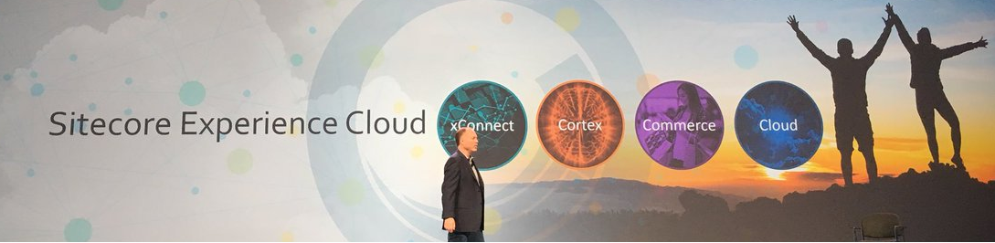
Sitecore Experience Cloud
Sitecore Experience Manager (web content management platform),
Sitecore Experience Platform (digital marketing platform, personalization, marketing automation, customer database and a new forms tool.),
Sitecore Experience Commerce (digital commerce platform )
Data & integration
Machine Learning
Commerce
Cloud

Slide 4
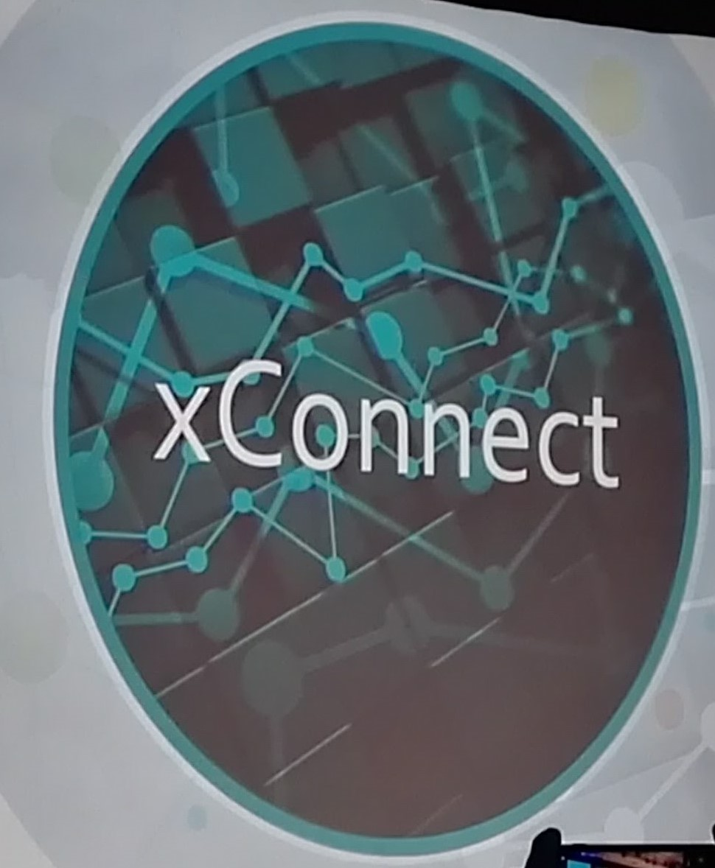
New API that allows you to capture, import and export data into xDB for every screen , device & any source
Omni-Channel collection at scale that can add data from CRM , ERP, Commerce , fit bands, lawn mowers ….
Cloud first approach
Secure, private customer data, GDPR Compliant
Put you in touch with Business intelligence tools , Machine learning capabilities
Sitecore build Connectors for Salesforce and Microsoft Dynamics 365 - based on Sitecore xConnect framework.
Help you have a holistic view of the customer

Slide 5
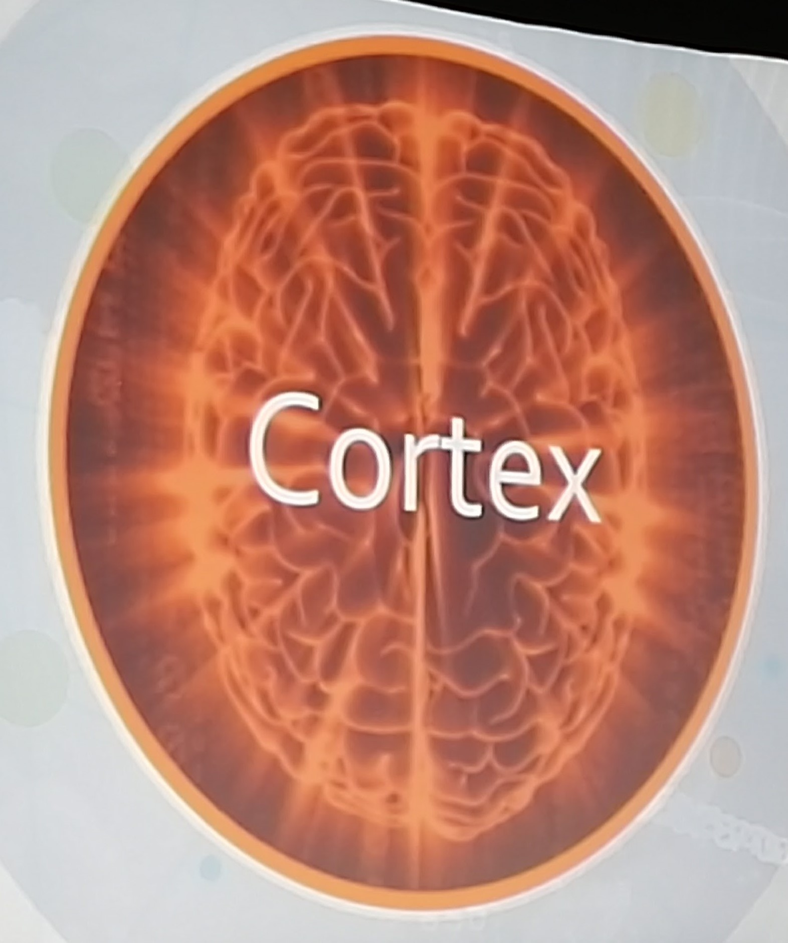
Machine Learning for real-time insights across native and third party customer data
Acts as a personal Data Scientist
that discover opportunities ,
get intelligent recommendations
reduce manual processes
Powerful insights from xDB data for marketers
Content scoring
Identify opportunities
Deliver better experiences
Identify new audience, scient discovering patterns
Running continuous multi variants testing
Automated personalisation!

Slide 6
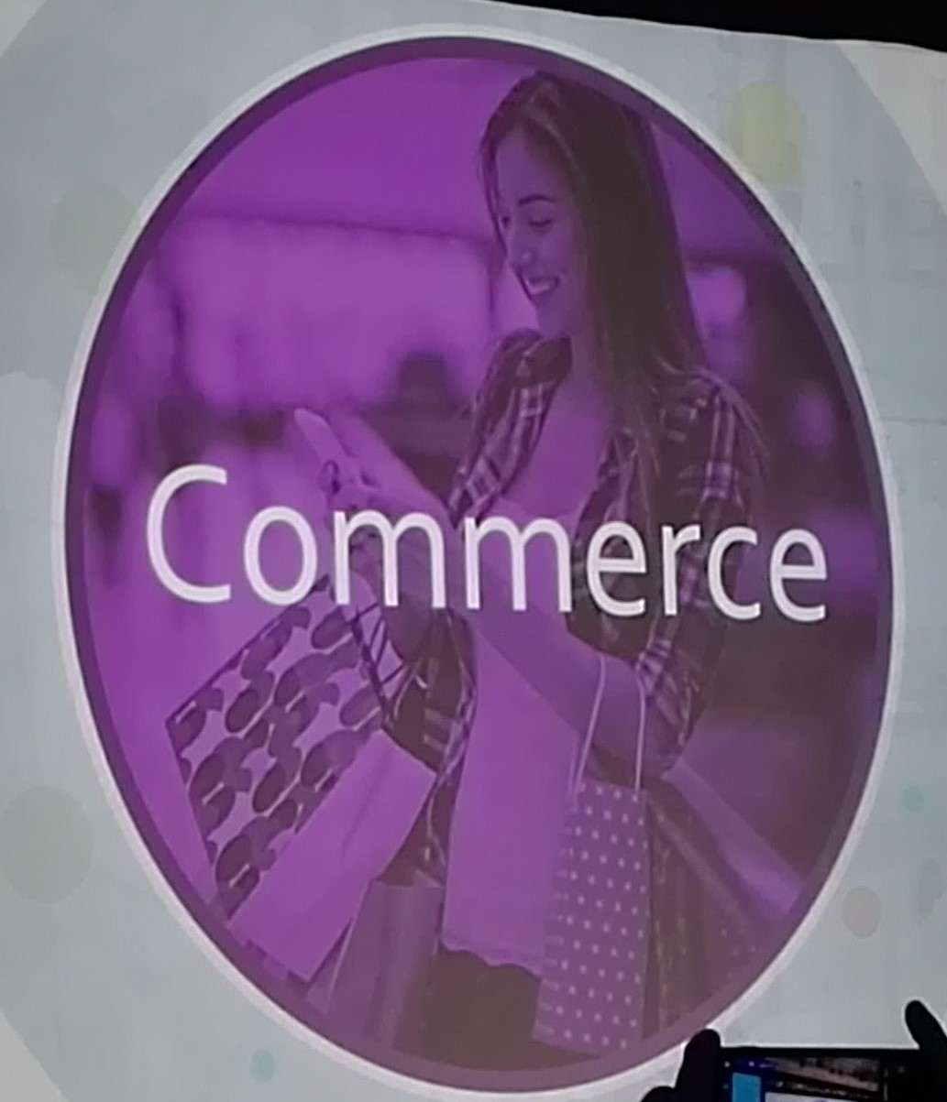
Revolutionizing commerce through personalized customer experience
Content and commerce together
Integrated marketing tools
Powerful pricing , promotions & order management
CRM integrations
Comprehensive user personalization
Replacement of Sitecore Commerce Server
Microservice architecture , Asp.net Core
Plug in approach(Nuget packages)
Designed for scalability, integration and cloud
Secure access via Federated Auth
Future cross operating system (Windows, Linux)

Slide 7
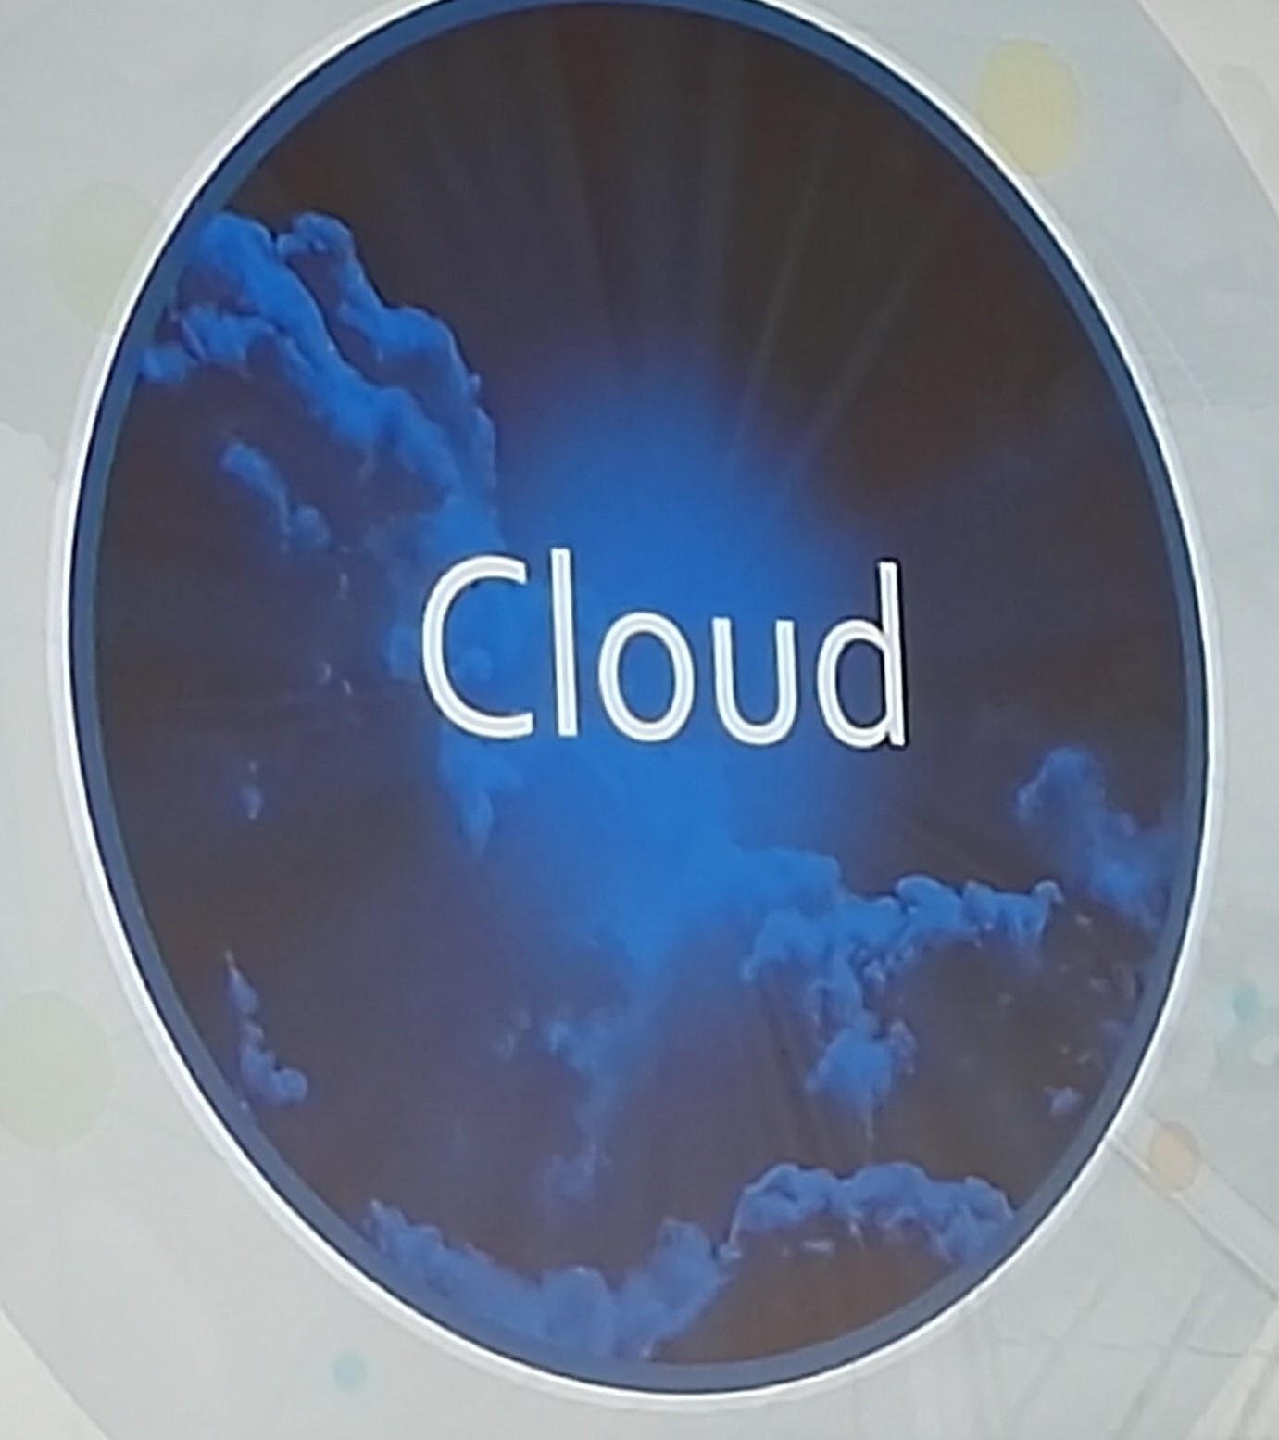
Sitecore’s Experience Cloud on Microsoft Azure
Combine the power of Sitecore with the speed & scale of cloud
Fast time to market
Native Azure support, Paas services
Secure , reliable , familiar
Allows you to fast scale up and out your delivery across the world.
Enables you to configure rules to add more servers when traffic spikes.
Allows you to tap into caching and search capabilities
Maximum freedom and flexibility
Deploy with no downtime

Slide 8
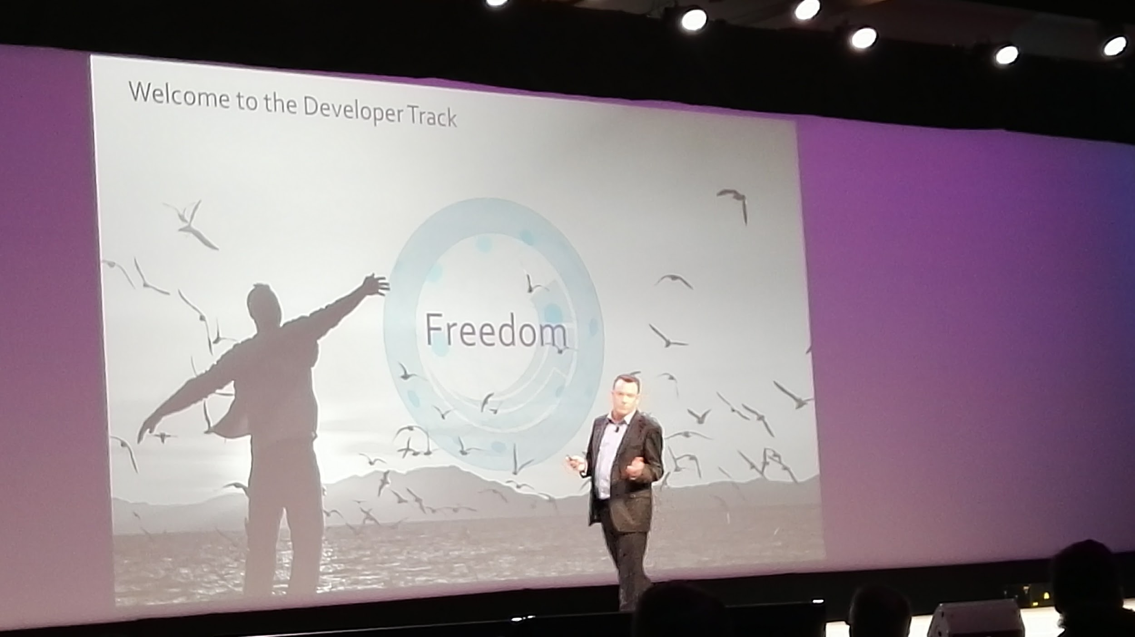
New Sitecore model : Freedom
Is now embracing more of the market trends and products emerging in the industry
Is now open to many new patterns and technologies that were out of reach previously, and have more tools to utilize them
Sitecore is very equipped to align to products in the industry

Slide 9
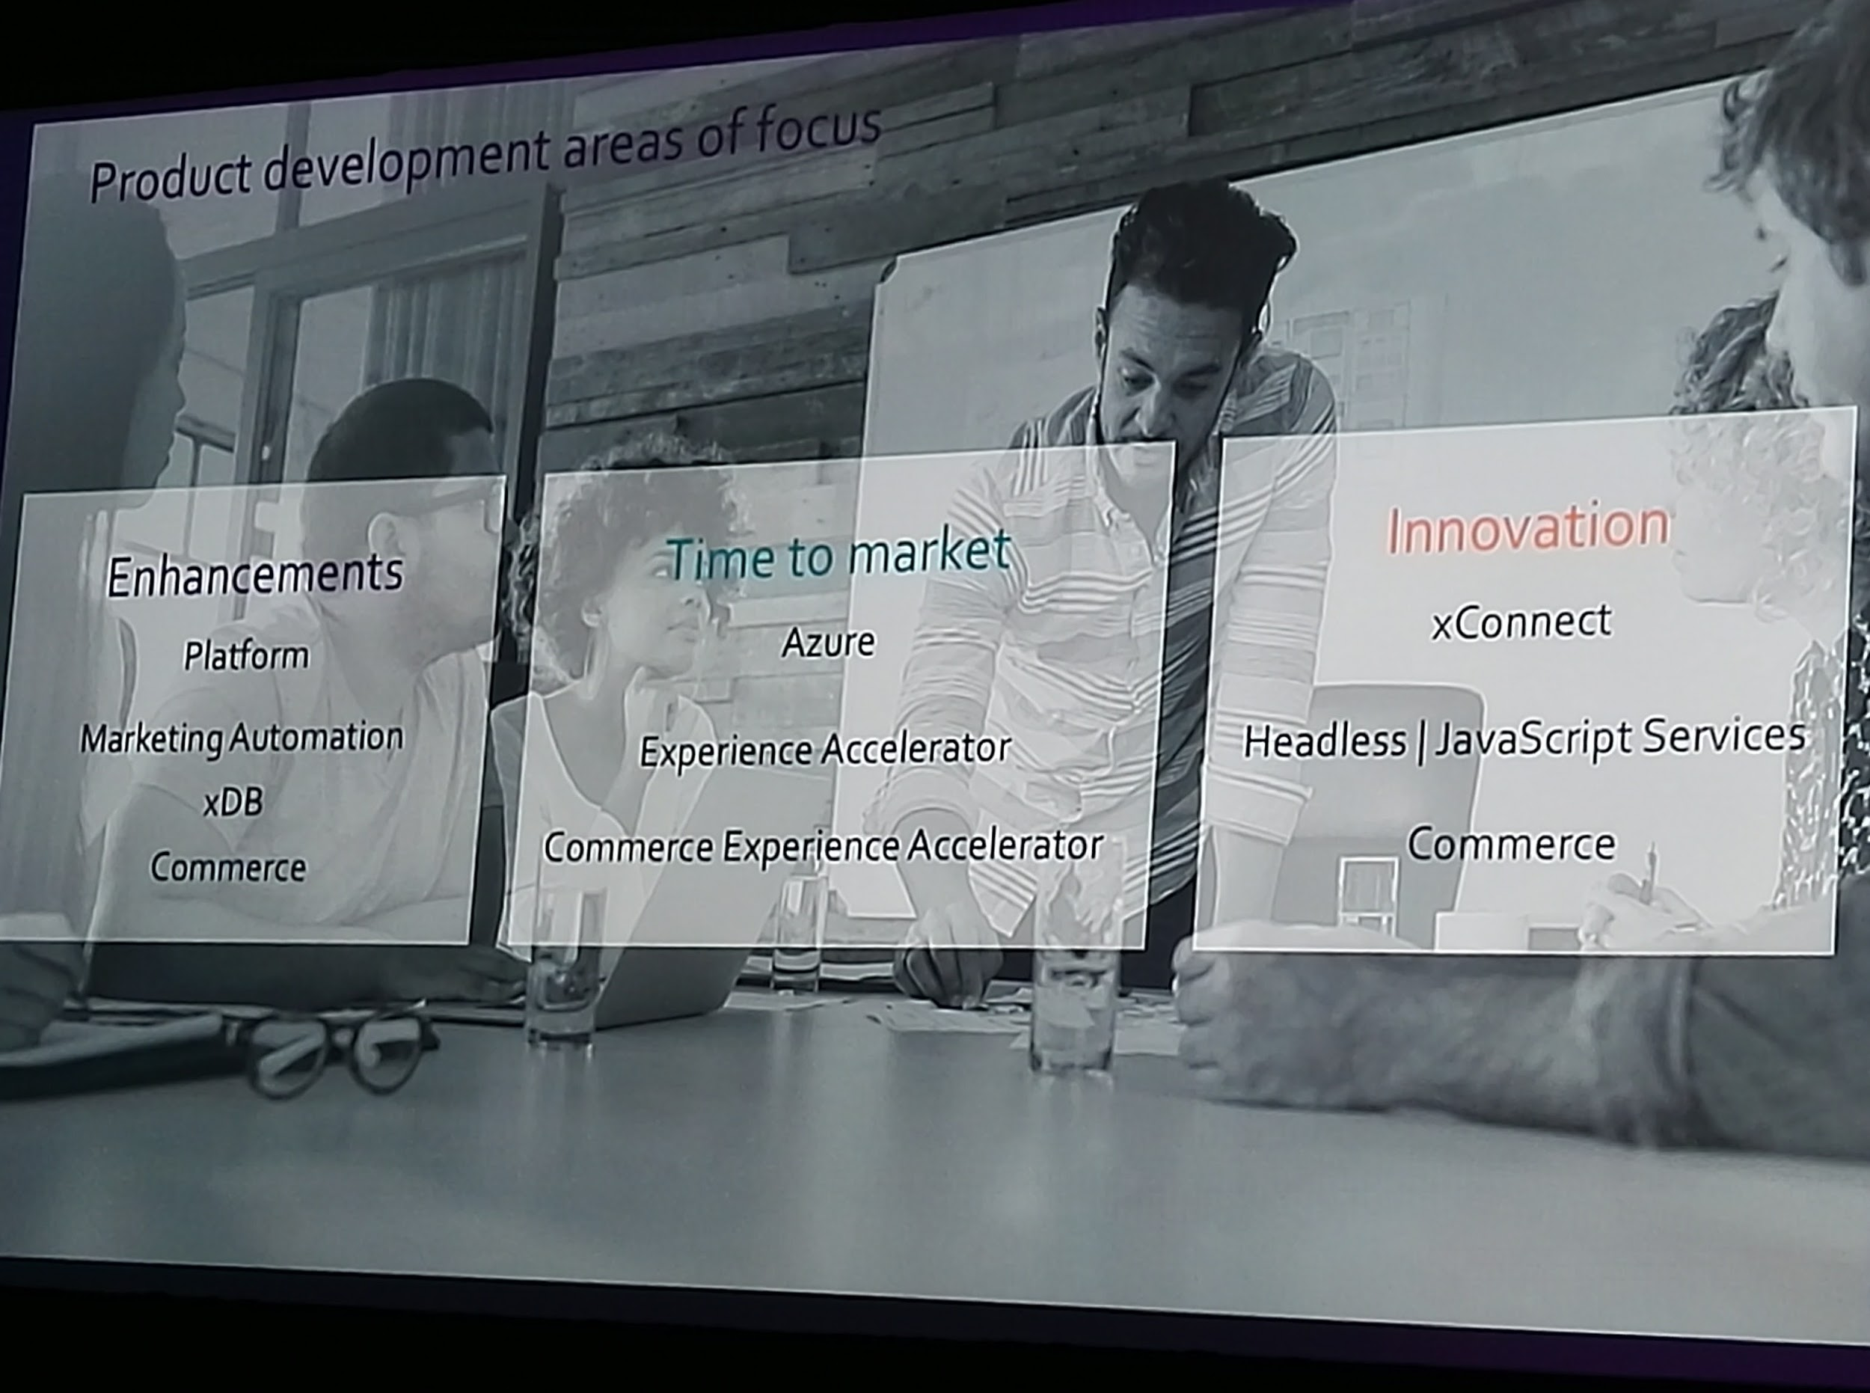
Experience Manager platform
From a core Experience Manager platform standpoint, the new 9 series is better than ever.
Three pillars of focus have been
Enhancements
Redefine configuration management
Overall quality
Performance improvements
New Marketing automation features, automation campaigns
Time to Market
New web forms
Improve Experience accelerator
Fast and easy upgrade
Innovation
xConnect
Extend Headless capabilities
New ecommerce

Slide 10
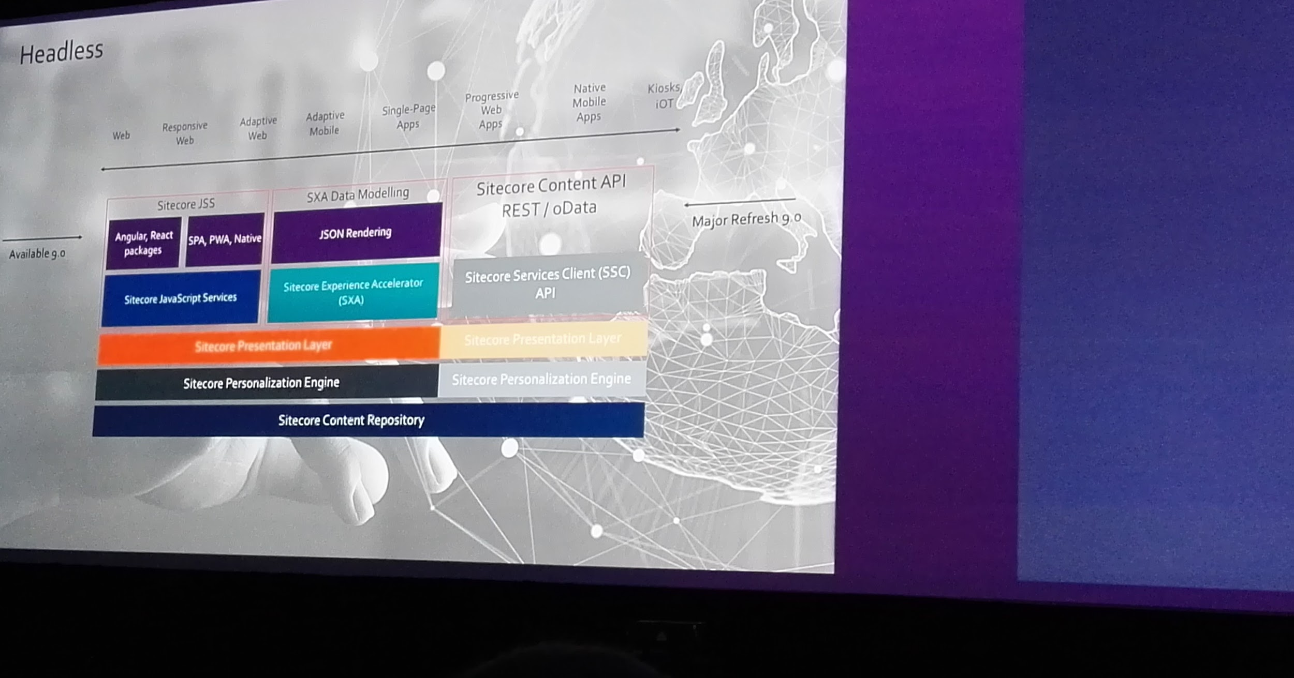
A Headless System
Sitecore understands the separation of content and presentation and Sitecore now has a framework called Sitecore JavaScript Services (JSS) that
Allows modern front-end developers to uses latest JS technologies to build web solution for Sitecore and maintain complete feature set.
Work disconnect from Sitecore
Utilize Layout Service
Allow Full editing , Testing , Personalization
Deploy application to physically decoupled node.js
This opens a lot of possibilities.

Slide 11
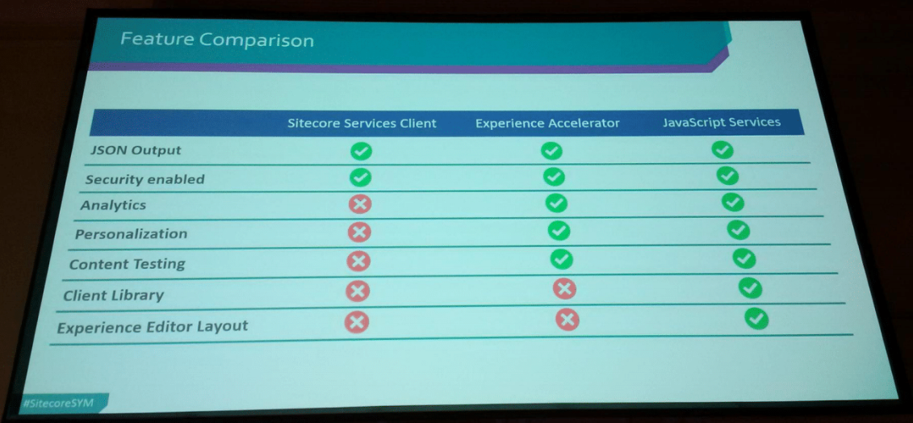

Slide 12
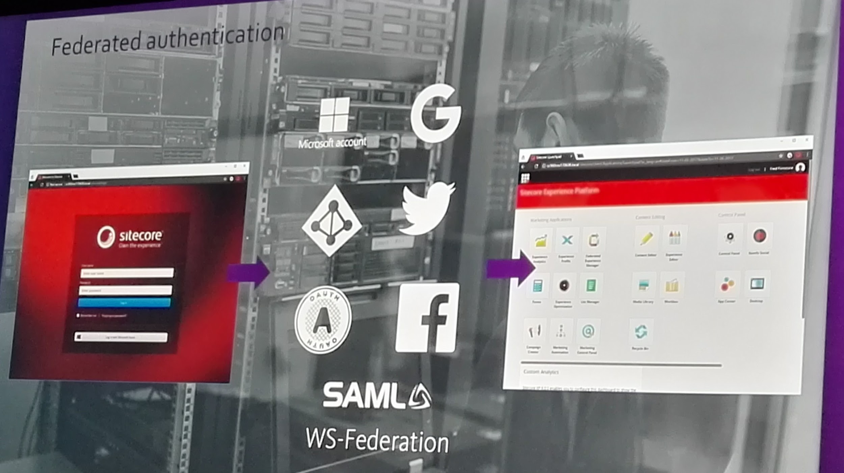

Slide 13
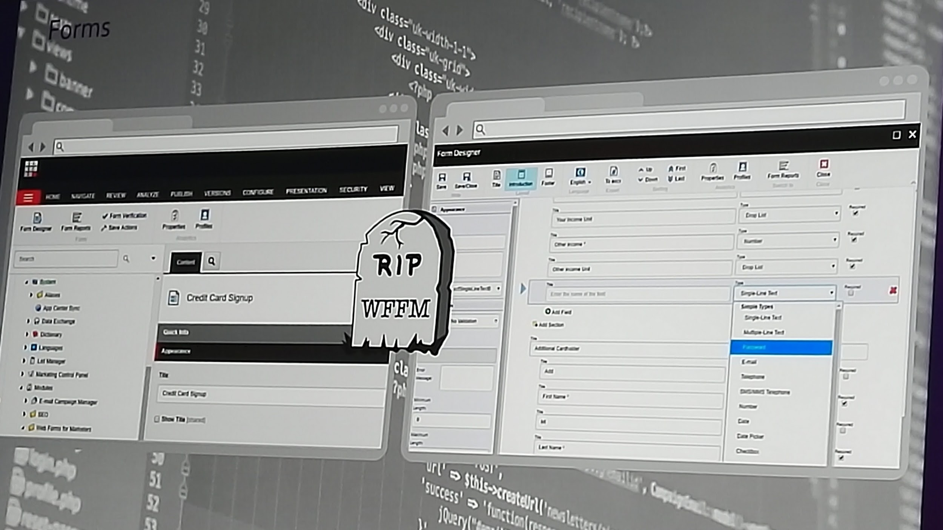

Slide 14
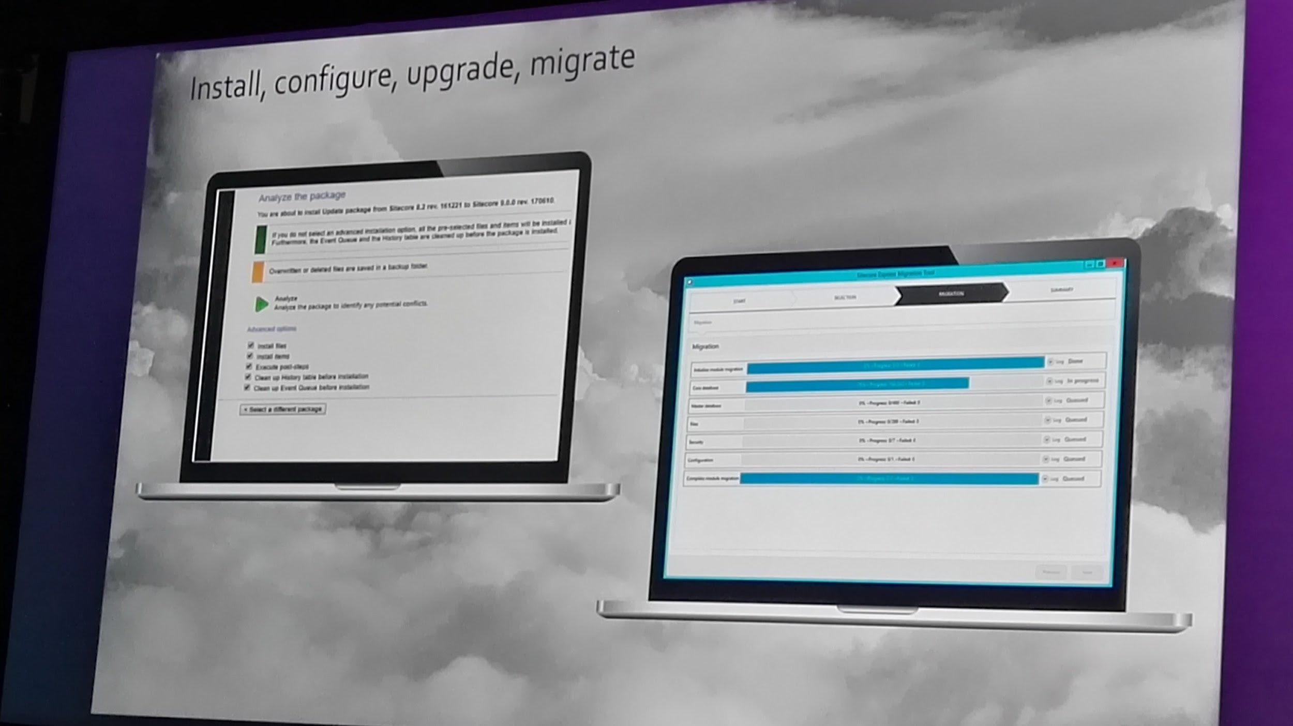
New Upgrade Tools with breaking change analysis

Slide 15
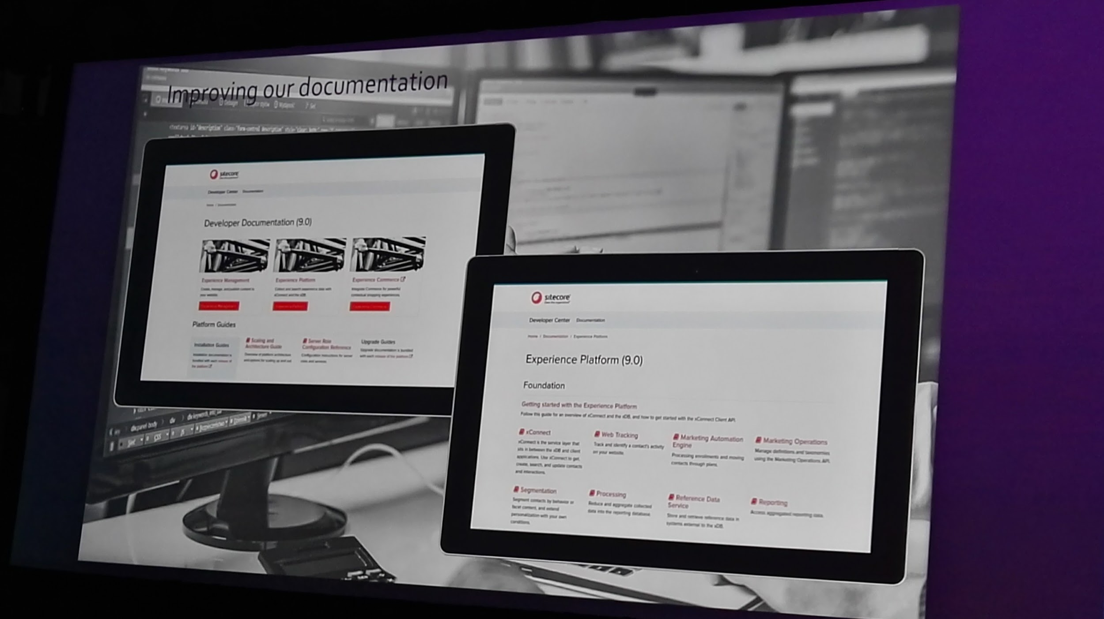

Slide 16
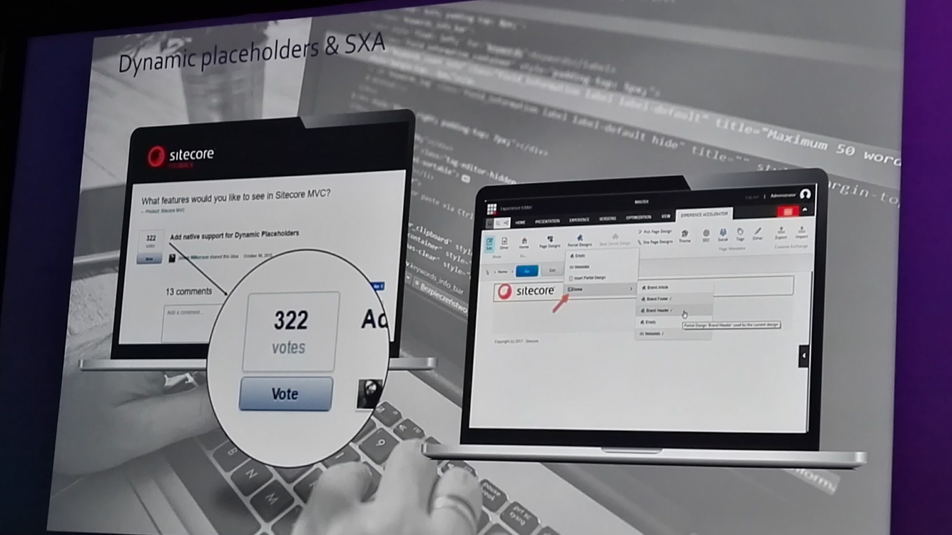

Slide 17
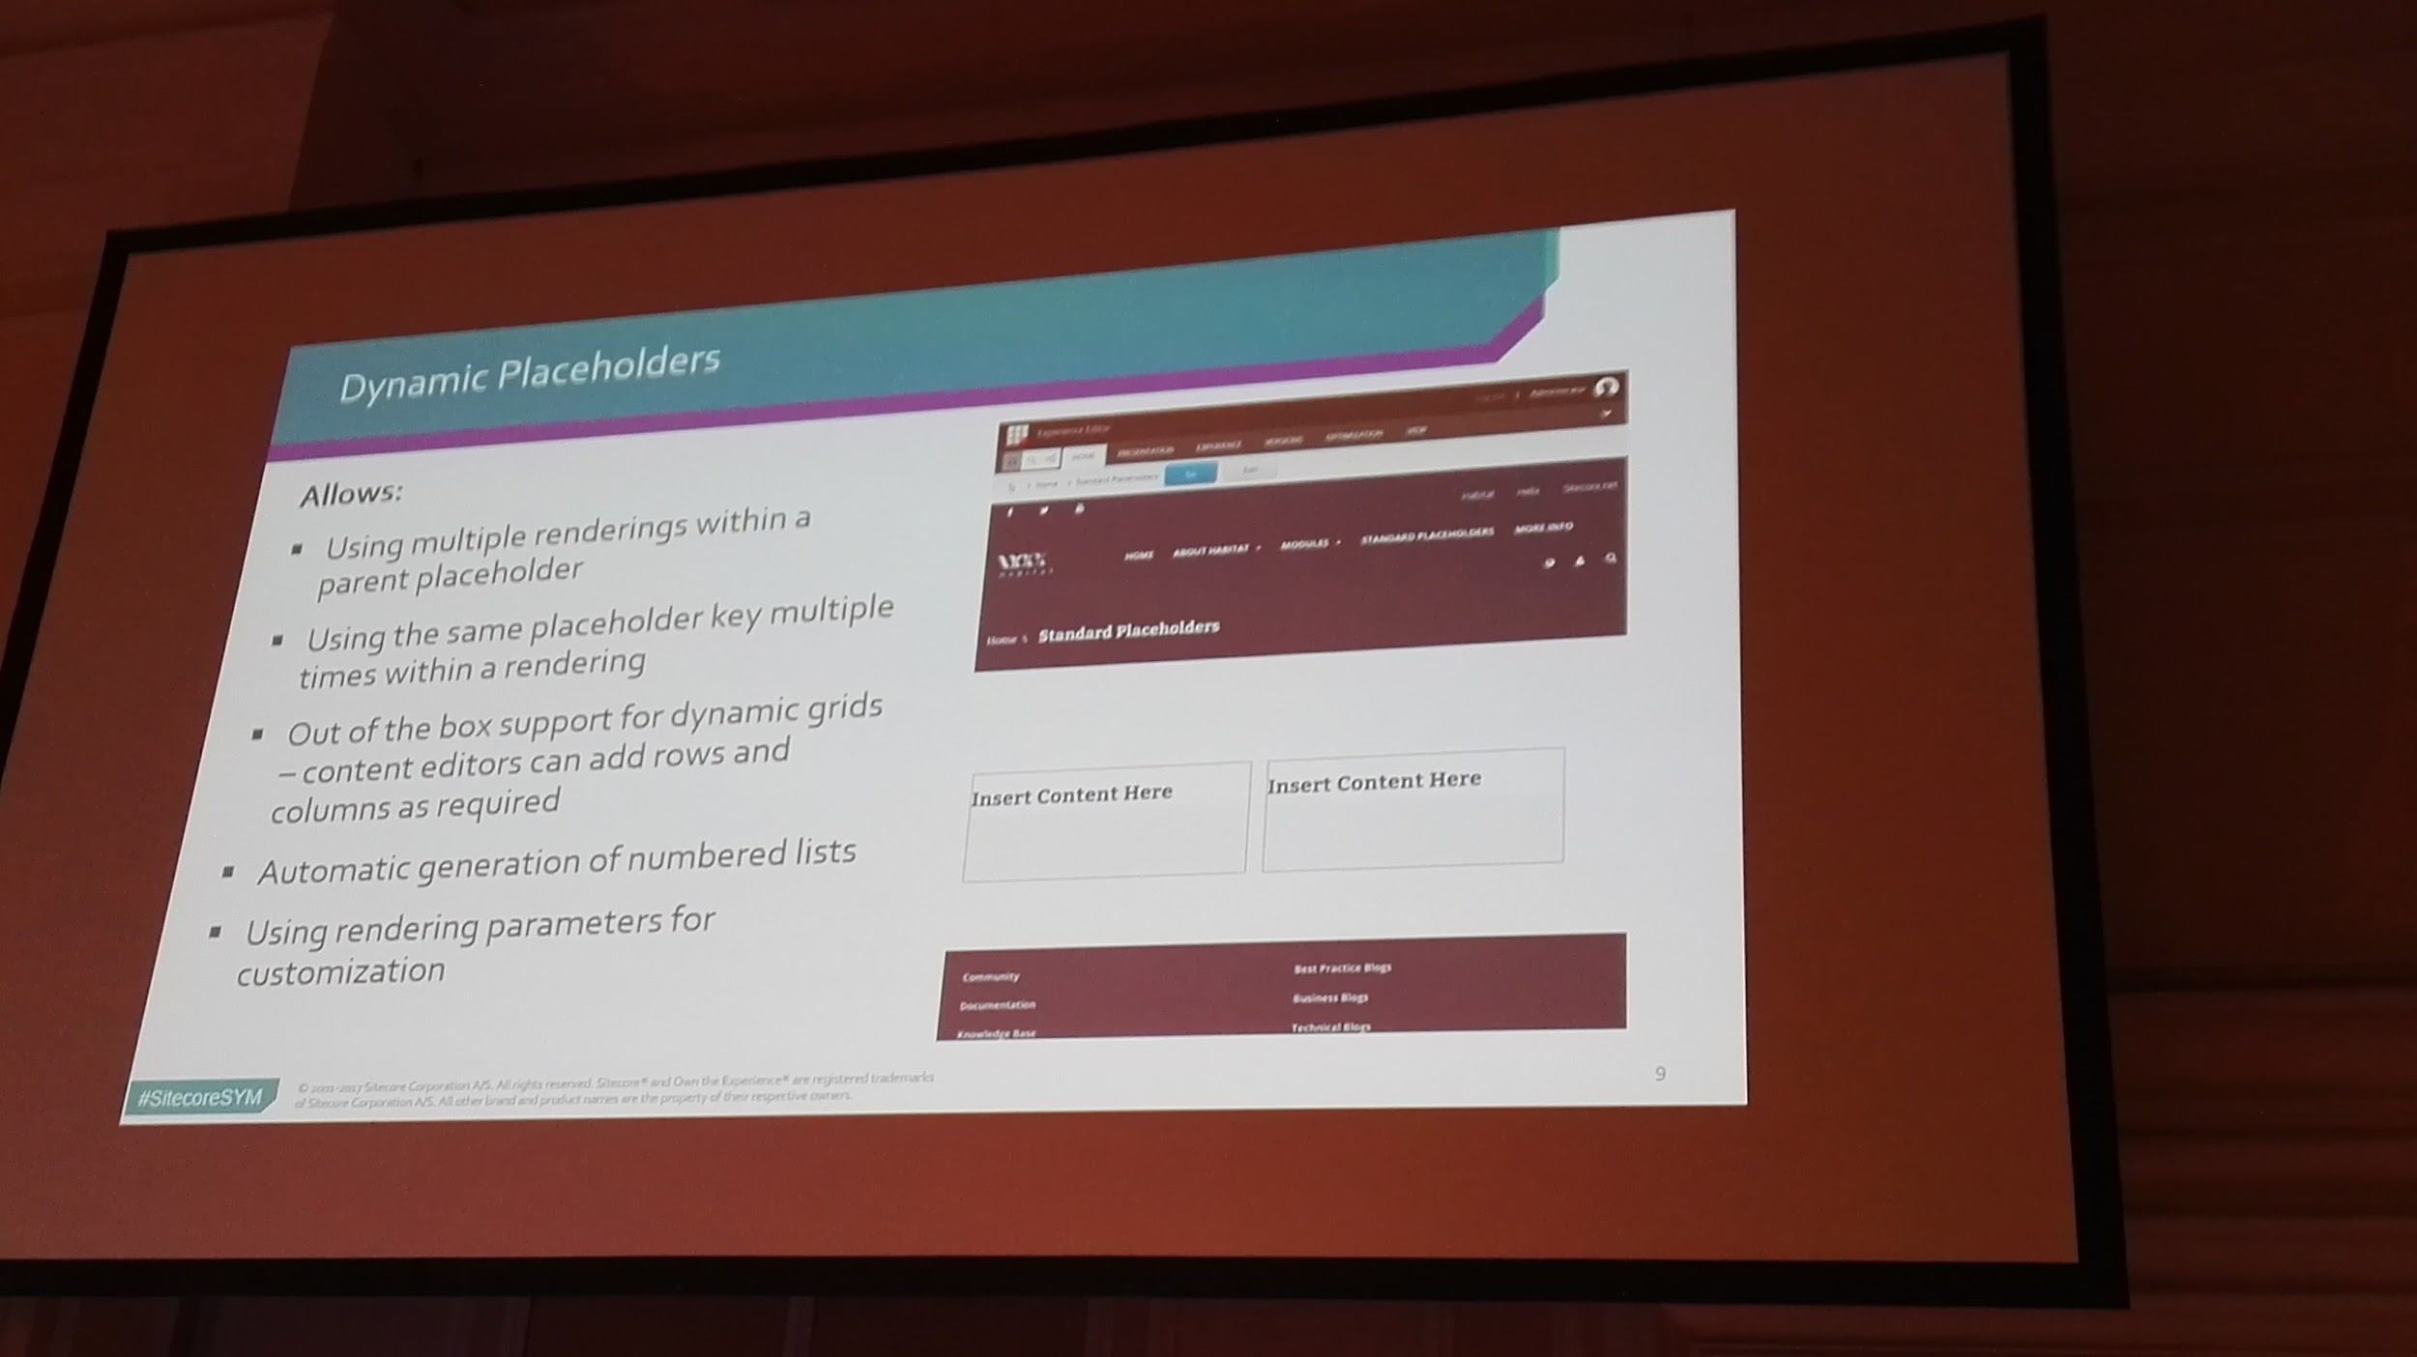

Slide 18
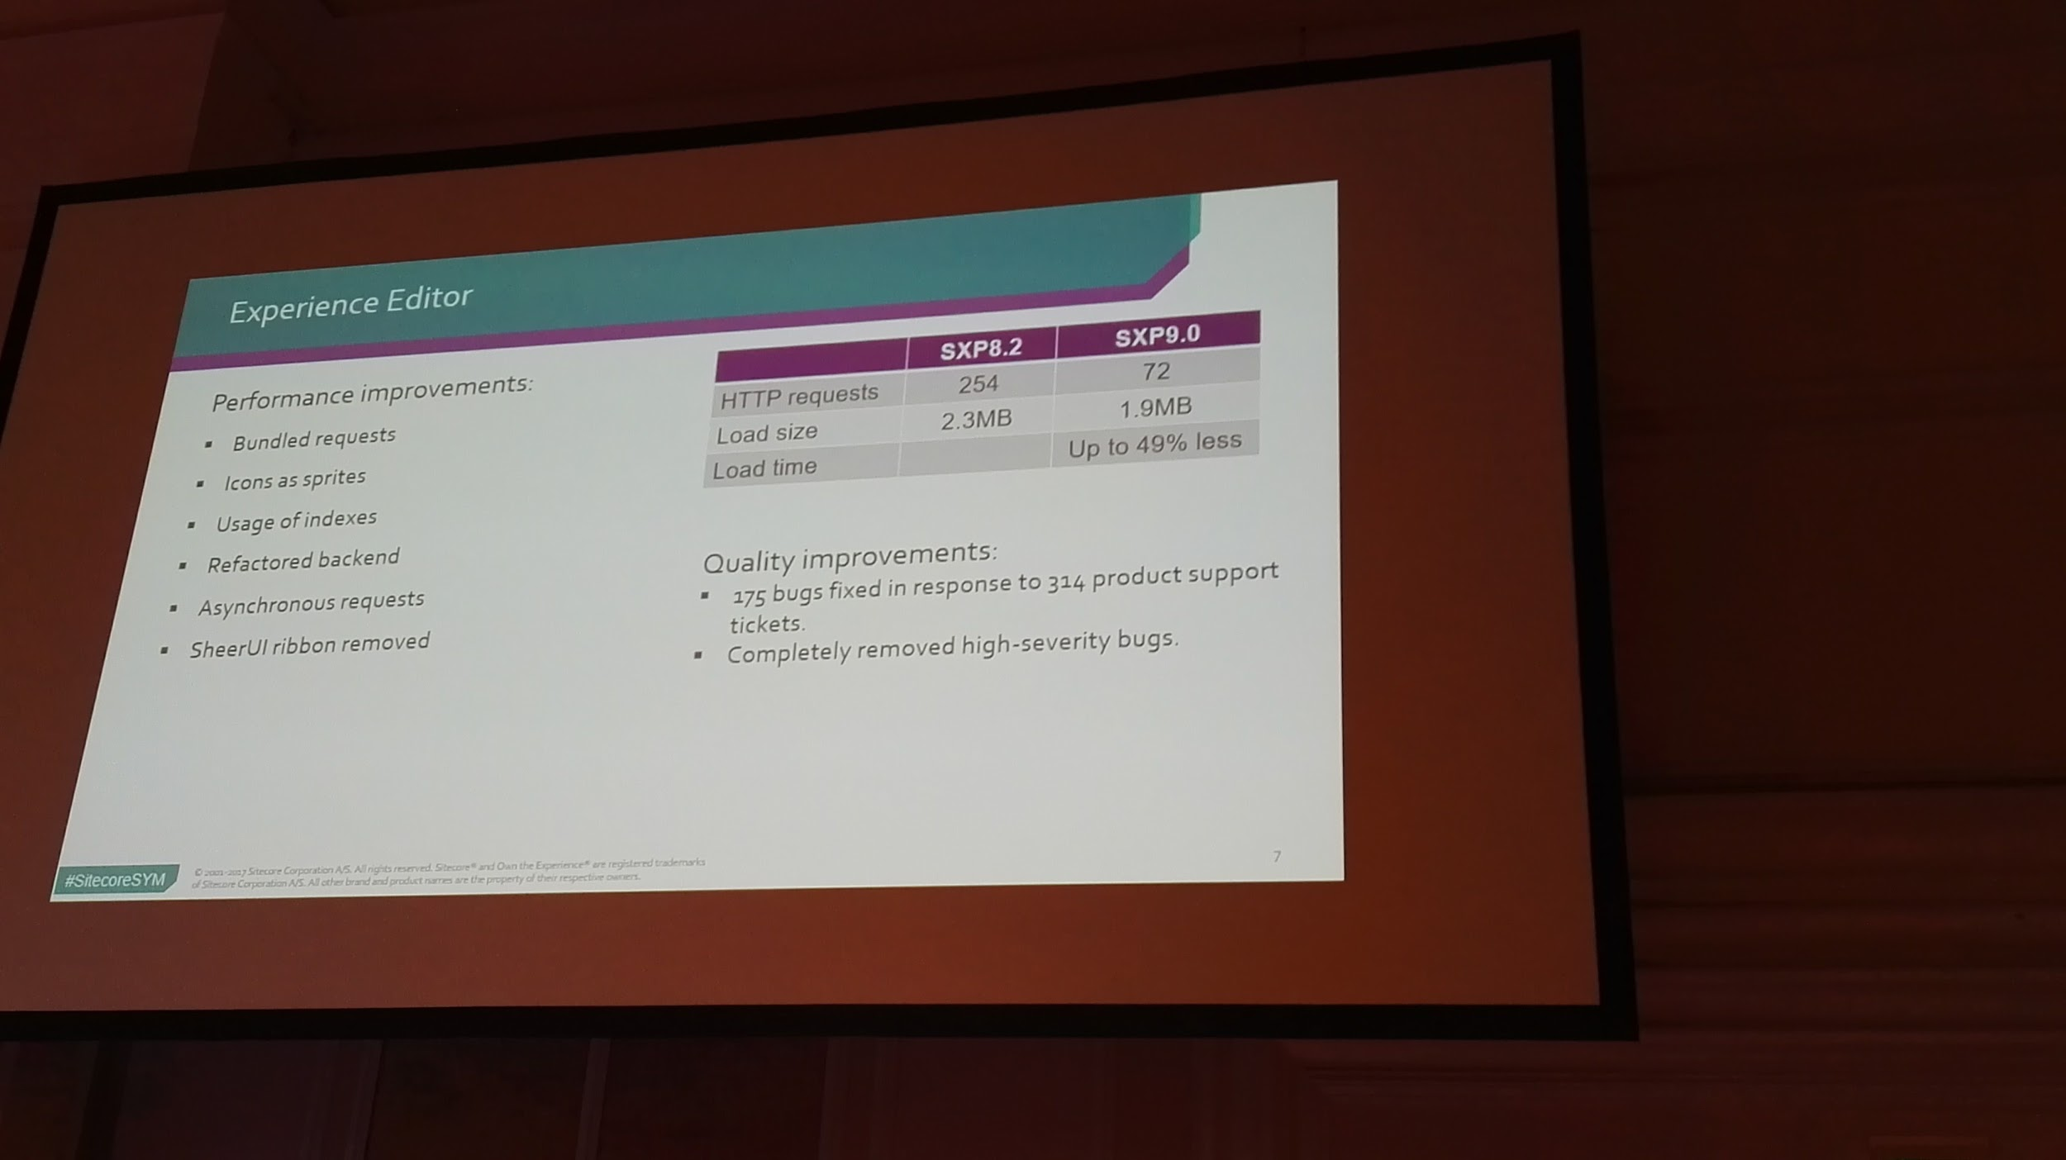

Slide 19
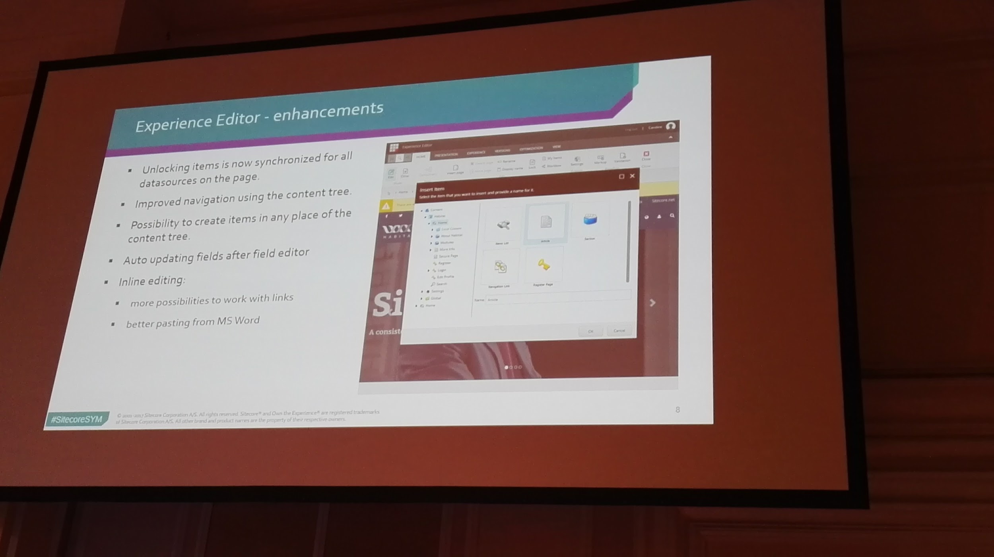

Slide 20
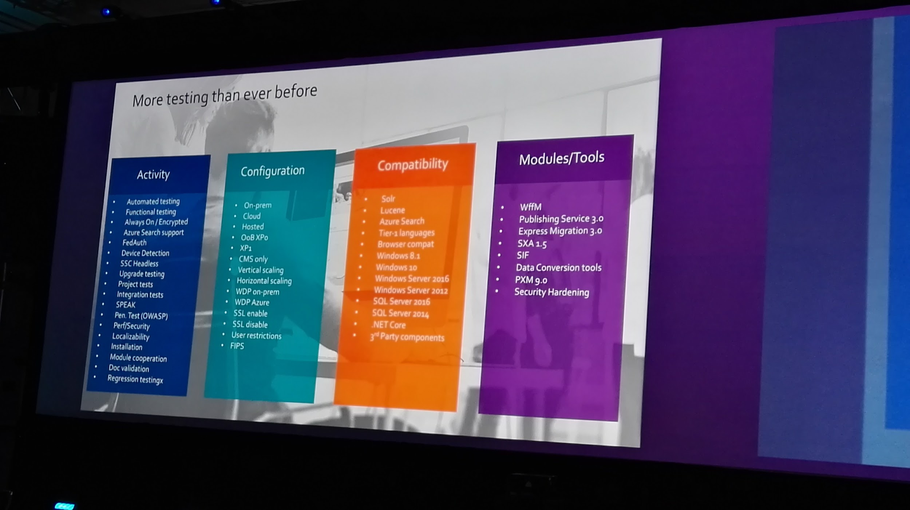

Slide 21
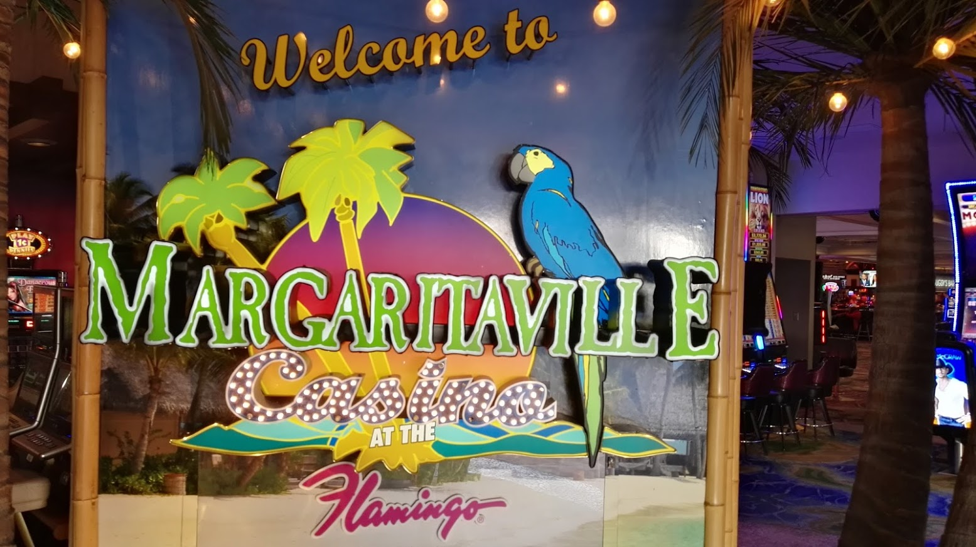
Other Sitecore 9 features
xDB dabases on SQL Azure , Sql 2016– enabled by the Sitecore xConnect layer (you don’t have to use MongoDB)
Sitecore Experience Accelerator (SXA 1.5)
Better support for multi sites and sharing
Automatic JSON feed of pages
Component innovations
New PowerShell based installation with role definitions
Configuration layers model to ease migration and support issues
Rule based configurations for each instance
OData Sitecore Service Client API
Prefetch cache optimisation
Index strategy optimisations
EventQueue performance

Slide 22
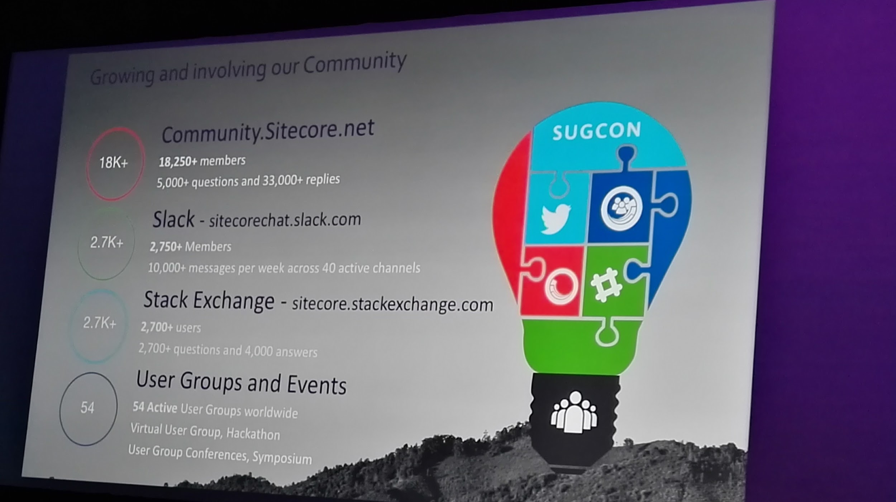

Slide 23
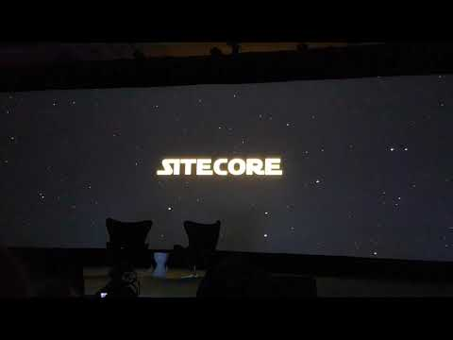
Closing Keynote : Mark Hamill and a Star Wars moment

Slide 24
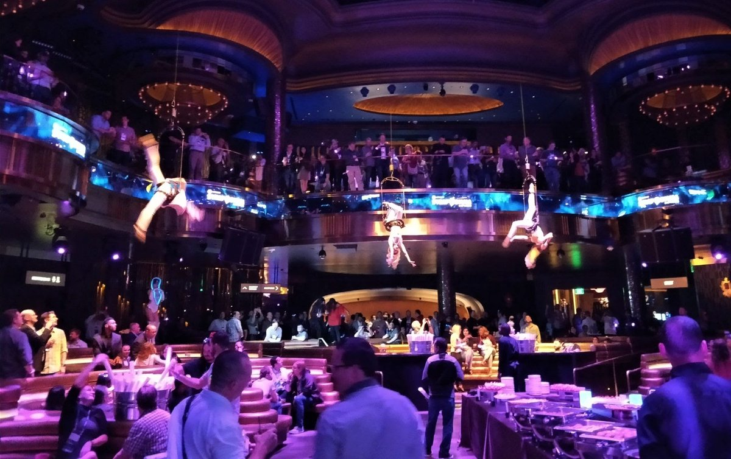
It Wasn’t Only Educational But Also Entertaining
Real party took place at Omnia Nightclub

Slide 25
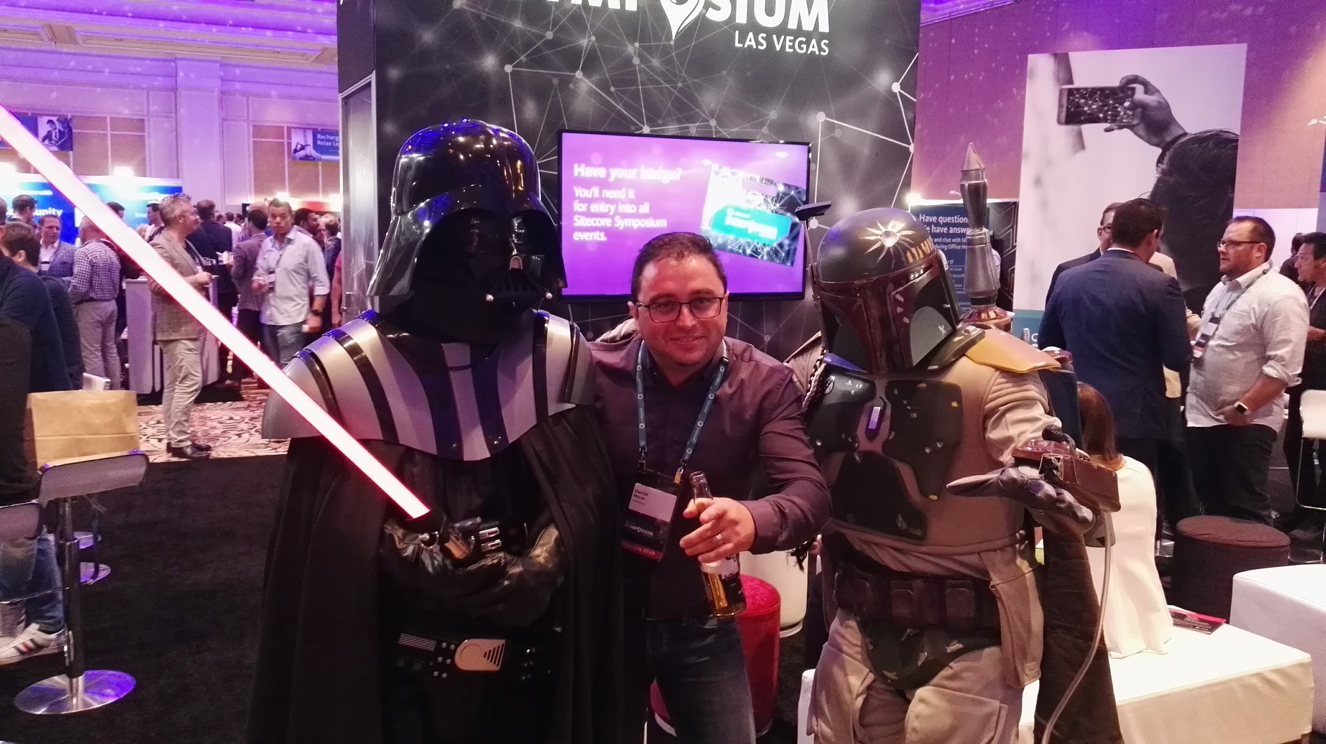



Thank you Daniel Mocan MVP 2017, Sitecore Architect @danimocan
sitecoreares.wordpress.com

